Slide 1
RPI Logger/Gateway setup
V3
If you don’t have the picture, you weren’t there

Slide 2
SMesh-x bringup - 1
64 bit lite no GUI (compatible with RPi 3, 4, 5)
phone hotspot WiFi information, user pi, password ceppsurc
Set ssh, wifi, country, timezone, etc
Hook up monitor
Ifconfig
Sudo apt update; sudo apt upgrade; sudo apt install x11-apps xterm

Slide 3
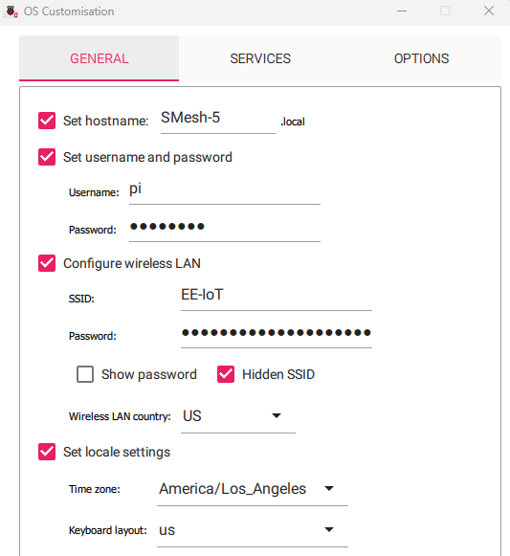
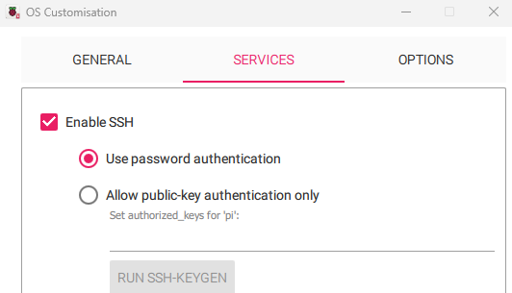

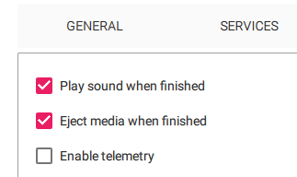
Creating an OS SD card
I am hopeful that
using a cell phone
hot spot will allow
“walk up and connect”
functionality. Put in your
hot spot’s SSID and
password. I am hopeful
that this will work when
there is no service to
connect your laptop to
Logger-Gateway node.
We can test in SSI’s
bunker which gets no
service but is on campus.
Let me know when you
want to try this.
ceppsurc
No GUI

Slide 4
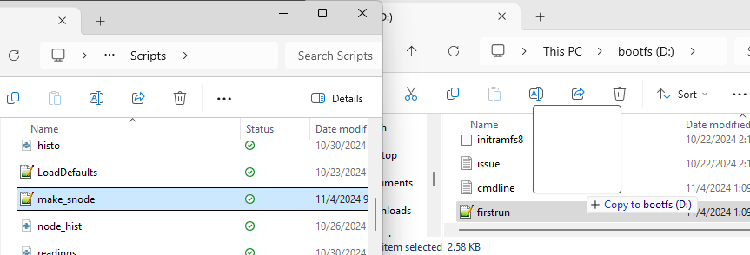
Copy files we’ll need later
only one partition is visible from Windows, but we can write files on it.
These files appear in /boot/firmware on the RPi after bootup
cp /boot/firmware/make_snode.sh .
tr -d ‘\r’ < make_snode.sh > make_sn.sh
chmod +x make_sn.sh .
./make_sn.sh

Slide 5
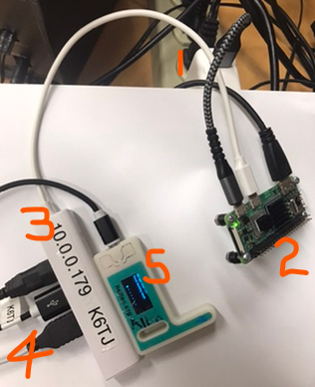
Setup for running the script
1) power brick with short wire
2) RPi Z 2 W
3) USB to Go dongle
4) Keyboard, Mouse and …
5) ...Reader Transceiver

Slide 6
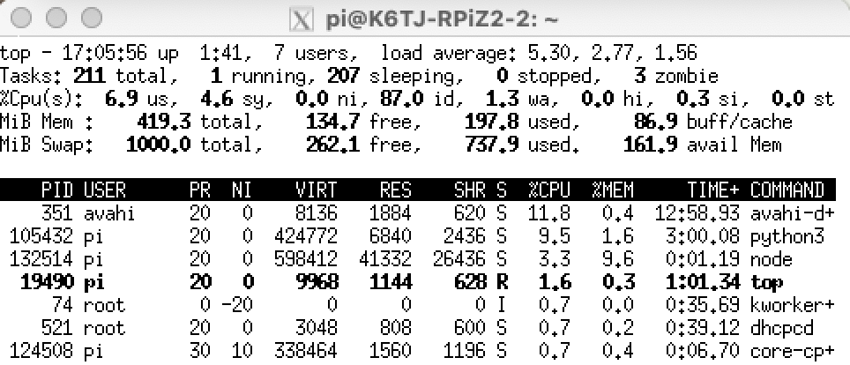
Increase swap
sudo nano /etc/sysctl.conf
# Changed swappiness from a default of 60 to 1 to decrease swap usage
vm.swappiness = 1
[turn off GUI in raspi-config]
sudo dphys-swapfile swapoff
sudo nano /etc/dphys-swapfile
sudo dphys-swapfile setup
sudo dphys-swapfile swapon
[turn on GUI in raspi-config]
sudo reboot now
1000 MB
Basecamp and VS Code Remote
https://pimylifeup.com/raspberry-pi-swap-file/

Slide 7
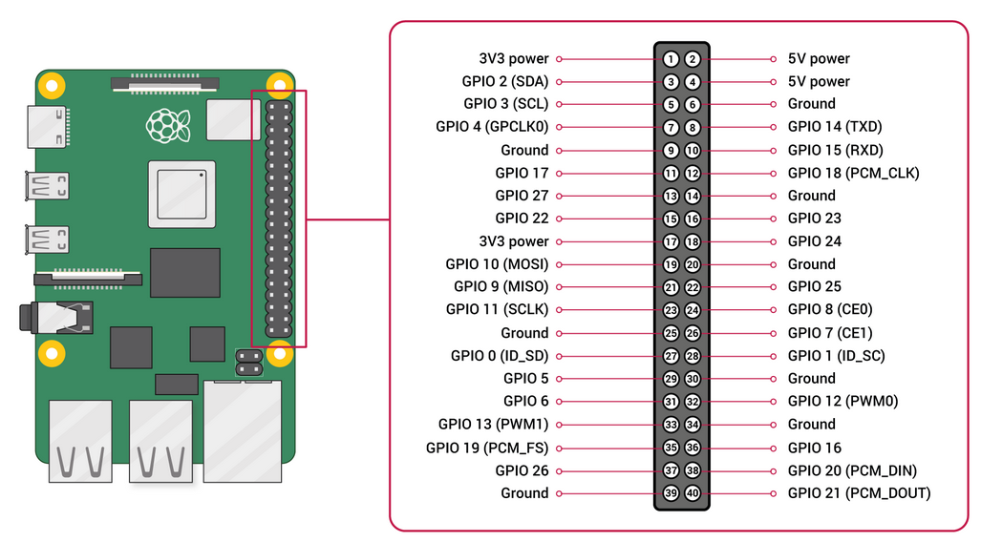
Raspberry Pi Pins

Slide 8
Connect to RPi
Use an ethernet cable from the RPi to your laptop, using a dongle at the laptop if necessary.
Share your WiFi internet connection with the wired ethernet port
arp -a or wireshark to get the autoconfigure address of the RPi
ssh -Y pi@w.x.y.z and run Xquartz or Xlaunch
  export DISPLAY=a.b.c.d:0.0
VNC w.x.y.z

Slide 9
read_aqi.py installation
Installing read_aqi.py on Raspberry Pi 4B
1) Install pipx by typing
sudo apt update
sudo apt -y upgrade
sudo apt -y install pipx
pipx ensurepath
2) install poetry by typing
pipx install poetry
pipx ensurepath
3) sudo apt -y install git; mkdir Documents; mkdir Documents/github; cd Documents/github
Download the programs from https://github.com/josdo/smesh into Documents/Github
3) cd to Documents/Github/smesh/snode and type
poetry install
poetry run python scripts/read_aqi.py /dev/ttyUSB0

Slide 10
Host ssh issues
ssh -Y pi@10.0.0.170
export DISPLAY=10.0.0.245:0.0 to see xwindows on host
If it won’t connect to a new RPi with the same hostname on the same IP address
  cd
  cd .ssh
  vi known_hosts
    Go to the end and delete the last few lines where it has an ssh key stored for that IP address.

Slide 11
crontab
crontab -e
add this
See the cron file:
  sudo cat /var/spool/cron/crontabs/pi
  crontab -l
reboot
look for the log file (cat or ls -la and look at date).
  cat /home/pi/Documents/github/smesh/snode/data/*.txt
@reboot source /home/pi/.bashrc; cd /home/pi/Documents/github/smesh/snode; /home/pi/.local/bin/poetry install; /home/pi/.local/bin/poetry run python scripts/read_aqi.py /dev/ttyUSB0 >>data/read_aqi_stdouterr_log.txt 2>&1

Slide 12
Package Corrupted
sudo rm -rf /var/lib/apt/lists/*
sudo rm -rf the packages that are corrupted
sudo mv <the packages that are corrupted> badblockn
sudo apt update

Slide 13
Install Meshtastic CLI
Not necessary but often handy
  pipx install meshtastic
  pipx ensurepath

Slide 14
Script to prepare a RPI Z
# Script to make a logging RPi for SMesh
# rename corrupted repositories on Pete's SD cards
sudo mv /var/lib/apt/lists/deb.debian.org_debian_dists_bookworm-updates_contrib_binary-arm64_Packages BadBlock1
sudo mv /var/lib/apt/lists/deb.debian.org_debian_dists_bookworm-updates_contrib_i18n_Translation-en BadBlock2
sudo apt -y install x11-apps xterm git pipx
sudo apt update
sudo apt -y upgrade
pipx ensurepath
pipx install poetry
pipx ensurepath
source .bashrc
cd
mkdir Documents
cd Documents
mkdir github
cd github
git clone https://github.com/josdo/smesh
cd smesh/snode
source /home/pi/.bashrc
poetry install
# Not necessary but sometimes useful when debugging
pipx install meshtastic
pipx ensurepath
echo "$(echo '@reboot source /home/pi/.bashrc; cd /home/pi/Documents/github/smesh/snode; /home/pi/.local/bin/poetry install; /home/pi/.local/bin/poetry run python scripts/read_aqi.py /dev/ttyUSB0 >>data/read_aqi_stdouterr_log.txt 2>&1' ;) " | crontab -
crontab -l
#Control-c out of this after you see it work
poetry run python scripts/read_aqi.py /dev/ttyUSB0

Slide 15
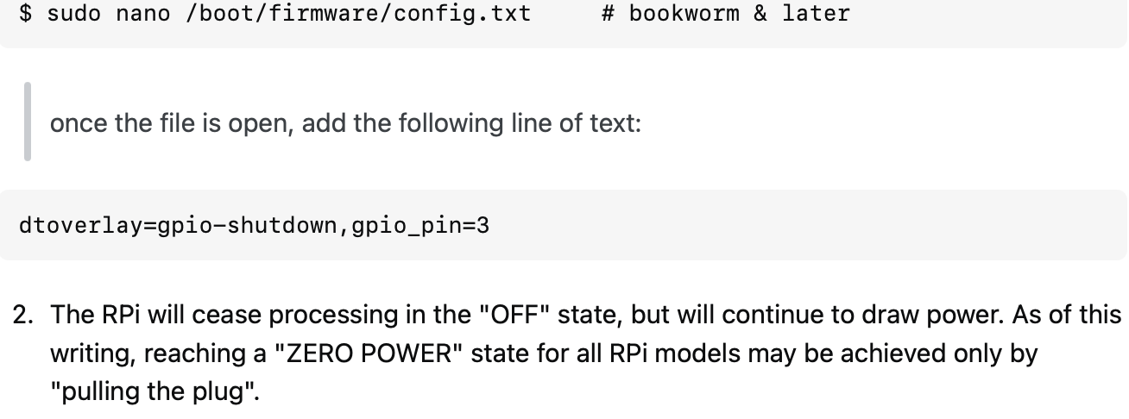
Install shutdown switch
See https://raspberrypi.stackexchange.com/questions/132585/three-pin-switch-for-on-off-pi-zero-w/132601#132601

